Slide 1
Objectives
In this session, you will learn to:
  Define a thread
  Create threads
  Control the execution of a thread and write
  platform-independent code with threads
  Understand the difficulties that might arise when multiple threads share data

Slide 2
Threads
A thread, or execution context, is considered to be the encapsulation of a virtual CPU with its own program code and data.
The class java.lang.Thread enables you to create and control threads.
A thread, or execution context, is composed of three main parts:
  A virtual CPU
  The code that the CPU executes
  The data on which the code works

Slide 3
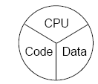
Threads (Contd.)
The following figure displays a thread that is composed of CPU, code, and data.
Code can be shared by multiple threads, independent of data.
Two threads share the same code when they execute code from instances of the same class.
Data can be shared by multiple threads, independent of code.
Two threads share the same data when they share access to a common object.

Slide 4
Creating the Thread
A Thread constructor takes an argument that is an instance of Runnable.
An instance of Runnable is made from a class that implements the Runnable interface.
A thread is referred to through an instance of a Thread object.
The thread begins execution at the start of a loaded Runnable instance’s run method.

Slide 5
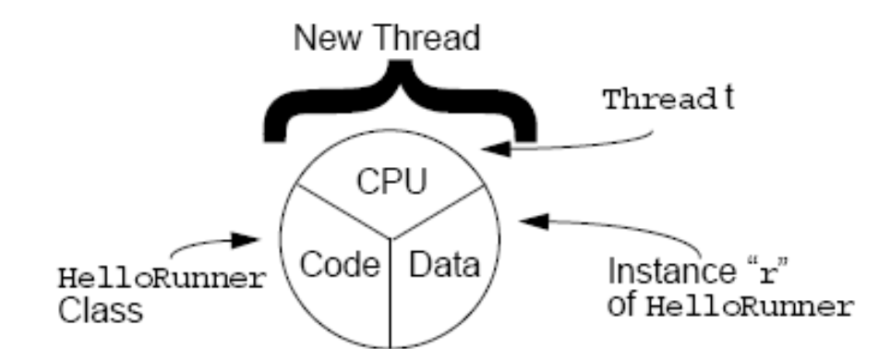
Creating the Thread (Contd.)
The data that the thread works on is taken from the specific instance of Runnable, which is passed to that Thread constructor.
The following figure displays a thread creation with the help of a Runnable instance.

Slide 6
Starting the Thread
A newly created thread does not start running automatically. Its start() method is called to run the thread.
Calling start() method places the virtual CPU embodied in the thread into a runnable state.
Calling start() method does not necessarily mean that the thread runs immediately.

Slide 7
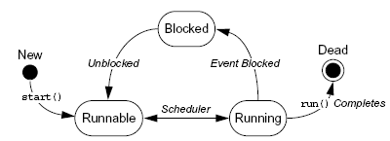
Thread Scheduling
In Java, all threads are pre-emptive, but not necessarily time-sliced.
The model of a pre-emptive scheduler is that many threads might be runnable, but only one thread is running.
The following figure displays a Thread object that can exist in several different states throughout its lifetime.

Slide 8
Thread Scheduling (Contd.)
The Thread.sleep() method can pause a thread for a period of time.
The sleep() is a static method in the Thread class, because it operates on the current thread and is referred to as Thread.sleep(x).
The sleep() method’s argument specifies the minimum number of milliseconds for which the thread must be made inactive.

Slide 9
Terminating a Thread
When a thread completes execution and terminates, it cannot run again.
You can stop a thread by using a flag that indicates that the run() method should exit.

Slide 10
Demo: Creating the Thread
Let us see the demonstration of creating threads.

Slide 11
Basic Control of Threads
The isAlive() method is used to determine if a thread is still viable.
The getPriority() method is used to determine the current priority of the thread.
The setPriority () method is used to set the priority of the thread.
The Thread class includes the following constants:
  Thread.MIN_PRIORITY
  Thread.NORM_PRIORITY
  Thread.MAX_PRIORITY
The join() method causes the current thread to wait until the thread on which the join() method is called terminates.

Slide 12
Basic Control of Threads (Contd.)
The Thread.yield() method is used to give other runnable threads a chance to execute.
If other threads are runnable, the yield() method places the calling thread into the runnable pool and allows another runnable thread to run.

Slide 13
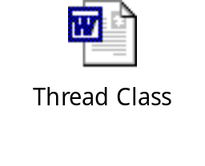
Other Ways to Create Threads
A thread is created by creating a class that extends Thread rather than implementing Runnable interface because the Thread class implements the Runnable interface itself.
Let us understand how to create a thread using Thread class by using the embedded document.

Slide 14
Selecting a Way to Create Threads
The advantages of implementing Runnable interface are:
  The Thread class is strictly an encapsulation of a virtual CPU and, as such, it should be extended only when you change or extend the behavior of that CPU.
  Java permits single inheritance only, you cannot extend any other class, such as Applet, if you have extended Thread class already.
The advantage of extending Thread class is that the code tends to be simpler.

Slide 15
Using the synchronized Keyword
The synchronized keyword provides the Java programming language with a mechanism that enables a programmer to control threads that are sharing data.
It is a mechanism to ensure that shared data is in a consistent state before any thread starts to use it for a particular task.

Slide 16
The Object Lock Flag
In Java technology, every object has a flag associated with it and is called as a lock flag.
The keyword synchronized enables interaction with this flag, and provides exclusive access to code that affects shared data.
The following code snippet displays the use of synchronized keyword:
  public class MyStack {
  ...
  public void push(char c) {
  synchronized(this) {
  data[idx] = c;
  idx++;}}
  ...}

Slide 17

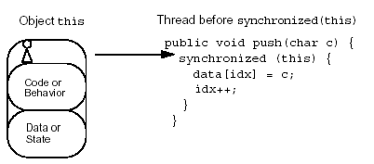
The Object Lock Flag (Contd.)
The following figure displays the object lock flag before synchronized statement.

Slide 18
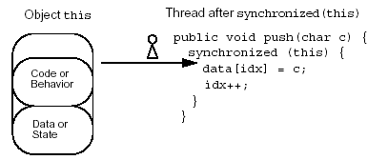
The Object Lock Flag (Contd.)
The following figure displays the object lock flag after synchronized statement.

Slide 19
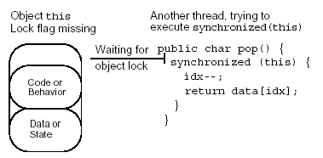
The Object Lock Flag (Contd.)
The following figure displays another thread that is trying to execute synchronized statement.

Slide 20
Releasing the Lock Flag
The lock flag is:
  Released when the thread passes the end of synchronized code block.
  Released automatically when a break, return, or an exception is thrown by the synchronized code block.

Slide 21
Using synchronized – Putting It Together
The synchronized mechanism works only if all access to delicate data occurs within the synchronized blocks.
Delicate data protected by synchronized blocks should be marked as private.
The following two code snippets are equivalent:
  public void push(char c) {
  synchronized(this) {
  // The push method code
  }
  }
  or
  public synchronized void push(char c) {
  // The push method code
  }

Slide 22
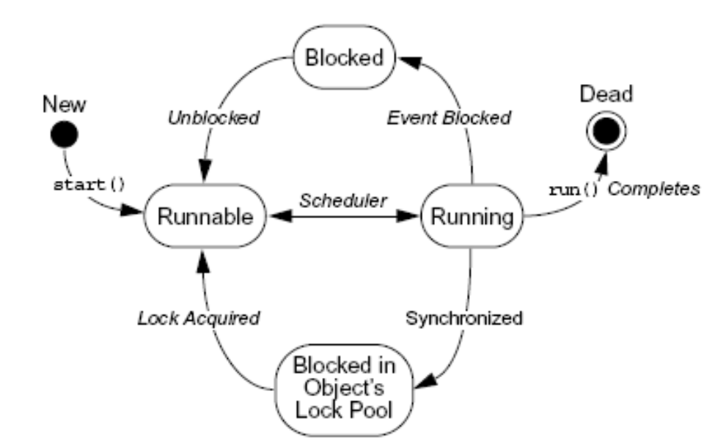
Thread States
The following figure displays a thread state diagram with synchronization.

Slide 23
Deadlock
A deadlock occurs when one thread is waiting for a lock held by another thread, but the other thread is waiting for a lock already held by the first thread.
A deadlock can be avoided by making a decision about the order for obtaining locks, adhering to this order throughout the program, and releasing the locks in reverse order.

Slide 24
Thread Interaction – wait and notify
Different threads are created specifically to perform unrelated tasks. However, sometimes the jobs they perform are related in some way and it might be necessary to program some interactions between them.
Scenario:
  Consider yourself and your cab driver as two threads.
Problem:
  How would you determine when you are at your destination?
Solution:
  You notify the cab driver of your destination and relax.
  The driver drives and notifies you upon arrival at your destination.

Slide 25
Summary
In this session, you learned that:
  The class java.lang.Thread enables you to create and control threads.
  A thread, or execution context, is composed of three main parts:
    A virtual CPU
    The code that the CPU executes
    The data on which the code works
  Thread is referred to through an instance of a Thread object.
  The thread begins execution at the start of a loaded Runnable instance’s run method.
  The data that the thread works on is taken from the specific instance of Runnable, which is passed to that Thread constructor.

Slide 26
Summary (Contd.)
  A newly created thread does not start running automatically. Its start method is called to run the thread.
  The Thread.sleep() method can pause a thread for a period of time.
  The isAlive() method is used to determine if a thread is still viable.
  The Thread.yield() method is used to give other runnable threads a chance to execute.
  A thread is created by creating a class that extends Thread rather than implements Runnable because the Thread class implements the Runnable interface itself.
  The synchronized keyword provides the Java programming language with a mechanism that enables a programmer to control threads that are sharing data.

Slide 27
Summary (Contd.)
  In Java technology, every object has a flag associated with it and is called as a lock flag.
  The lock flag is:
    Released when the thread passes the end of synchronized code block.
    Released automatically when a break, return, or an exception is thrown by the synchronized code block.
  A deadlock occurs when one thread is waiting for a lock held by another thread, but the other thread is waiting for a lock already held by the first thread.

